Slide 1
RAJALAKSHMI ENGINEERING COLLEGE
Department of Artificial Intelligence and Data Science
IT19541 Web Technology
MINI PROJECT
Exam Seat Arrangement System
Project by,
Sandhya J (221801044)
Tanushri G V S (221801055)
Date Slide Number

Slide 2
OUTLINE
Objectives
Abstract
Introduction to Problem Domain
Existing system
Limitation of the Existing System
Proposed system
Architectural design for Proposed system
ER ,Use case Diagram
Algorithm/Technique Used
Module Description
Results and Discussions
References
Date Slide Number

Slide 3
OBJECTIVE
To develop a web-based Exam Seat Arrangement System that automates and optimizes the allocation of students to examination halls, reducing manual effort, minimizing errors, and ensuring efficient use of resources.
Date Slide Number

Slide 4
ABSTRACT
Conducting examinations in educational institutions requires careful planning to allocate students to appropriate seating arrangements while preventing conflicts and maintaining order. Traditional methods, such as manual seat assignment using spreadsheets or paper records, are time-consuming and prone to errors. This project introduces an automated Exam Seat Arrangement System that dynamically assigns students to examination halls based on predefined rules such as room capacity, subject combinations, and institutional constraints. The system ensures seamless management of examination logistics, improves efficiency, and enhances security by implementing user access controls. Additionally, it provides real-time seat allocation, automated conflict resolution, and intuitive reporting, making examination management more streamlined and effective.
Date Slide Number

Slide 5
INTRODUCTION TO PROBLEM DOMAIN
Educational institutions often conduct multiple examinations simultaneously, requiring careful coordination of students, subjects, and available rooms. The manual process of arranging seats is not only tedious but also highly susceptible to human errors. Common issues include overcrowding, seat duplication, misallocation of students, and scheduling conflicts. Furthermore, changes in student numbers or last-minute adjustments can create confusion. Without an efficient seat allocation system, institutions face delays, mismanagement, and increased administrative workload. A digital solution that automates seat assignment while considering institutional constraints can significantly improve the accuracy, scalability, and reliability of exam management.
Date Slide Number

Slide 6
EXISTING SYSTEM
Sr. No | Author(s) | Year | Technique | Description | Outcome
1 | Smith et al | 2018 | Manual Seating Arrangement | Traditional paper-based method where exam administrators manually assign seats based on lists. | Time-consuming, error-prone, and difficult to scale for large student populations.
2 | John & Doe | 2020 | Spreadsheet-Based System | Use of Excel spreadsheets to manually allocate students to seats and generate seating plans | Reduces paperwork but still requires manual updates and lacks dynamic seat allocation.
3 | Kumar et al | 2021 | Basic Software System | A standalone desktop application that assigns seats but lacks integration with student databases. | Semi-automated but does not handle last-minute changes efficiently.
4 | Lee & Chang | 2022 | Web-Based Seating Tool | An early-stage web application for seat allocation using predefined rules. | Provides partial automation but lacks real-time seat adjustment and conflict resolution.
5 | Patel & Sharma | 2023 | AI-Based Smart Allocation | Uses AI algorithms to optimize seat assignments dynamically based on student count and room availability. | Improves efficiency and reduces errors, but requires advanced computational resources and initial setup complexity.
Date Slide Number

Slide 7
LIMITATIONS OF EXISTING SYSTEM
Sr. No | Limitation
1 | Error-Prone Process: Manual seat assignments often result in seat duplications, student misplacement, or incorrect scheduling.
2 | Time-Consuming: Administrative staff must repeatedly update seat assignments whenever there are student or room changes.
3 | Scalability Issues: Existing methods struggle to handle large student populations and multi-subject scheduling efficiently.
4 | Lack of Real-Time Updates: Changes in exam schedules or student lists cannot be updated dynamically, requiring manual reconfiguration.
5 | Security Concerns: Without proper access controls, exam seating information may be prone to manipulation or unauthorized changes.
Date Slide Number

Slide 8
PROPOSED SYSTEM
The Exam Seat Arrangement System automates the entire process of allocating seats to students based on predefined institutional rules. The system offers:
User Access Control: Ensures only authorized users (admin, faculty) can manage seating data.
Automated Room & Seat Allocation: Assigns students dynamically based on room capacity and subject combinations.
Conflict-Free Scheduling: Prevents seat duplication and scheduling conflicts, ensuring an organized exam environment.
Real-Time Updates: Allows modifications to student lists, room assignments, or schedule changes without requiring manual rework.
Visual Representation & Reports: Generates seating charts and detailed reports for easy monitoring and validation.
Date Slide Number

Slide 9
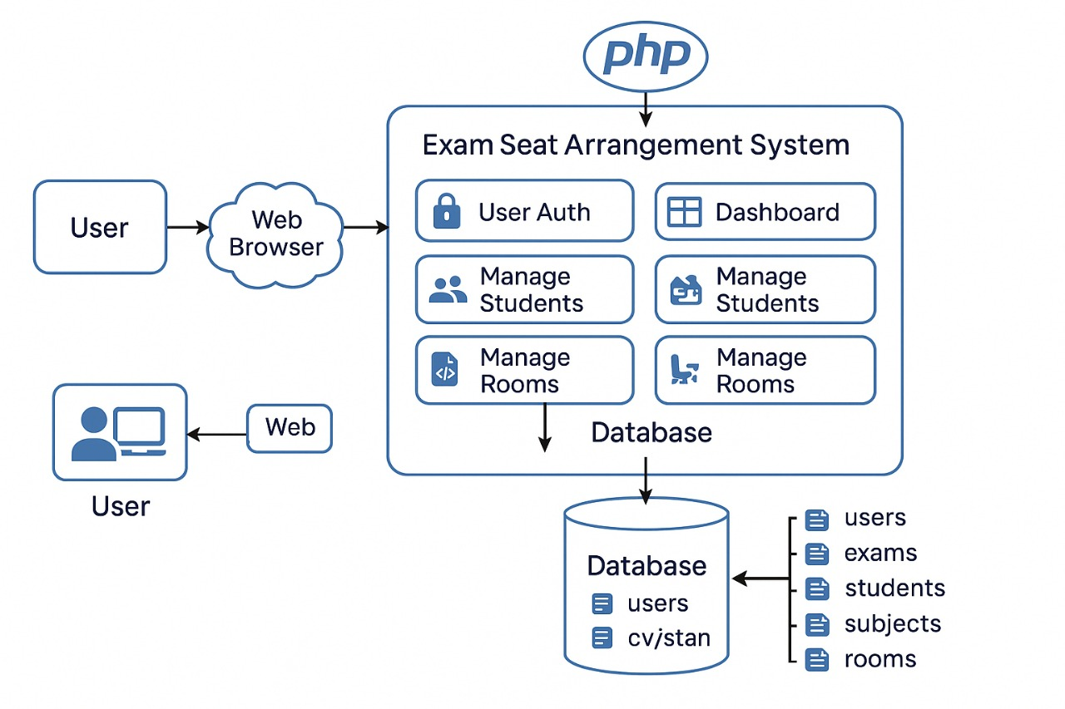
ARCHITECTURAL DESIGN FOR PROPOSED SYSTEM
Date Slide Number

Slide 10
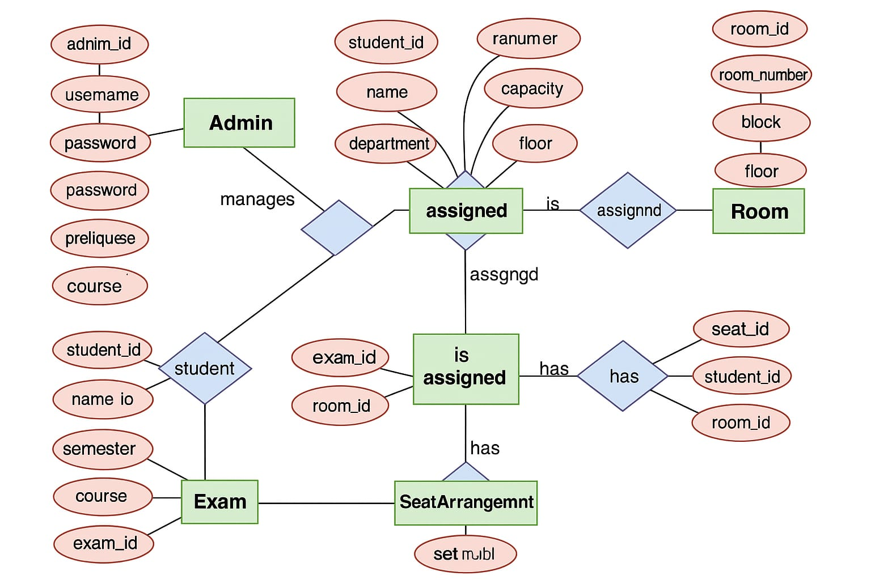
ER/ USE CASE DIAGRAM
Date Slide Number

Slide 11
ALGORITHM/ TECHNIQUE USED
Login Admin → Validate username & password.
Add Data → Insert students, rooms, and exams into the database.
Generate Seating → Assign students to rooms based on capacity.
Store Arrangement → Save student-room-seat mapping.
View/Print Arrangement → Display seating layout for the selected exam.
Logout → End admin session.
Date Slide Number

Slide 12
Results and Discussions
The Exam Seat Arrangement System successfully automates seat allocation, reducing manual effort and errors. It adapts to various room sizes and student groups, ensuring efficient and conflict-free arrangements. Testing confirmed accurate seat assignments and secure access control. Faculty feedback highlighted the system’s ease of use, real-time updates, and helpful reporting features. Overall, the tool enhances exam planning by saving time and improving organization.
Date Slide Number

Slide 13
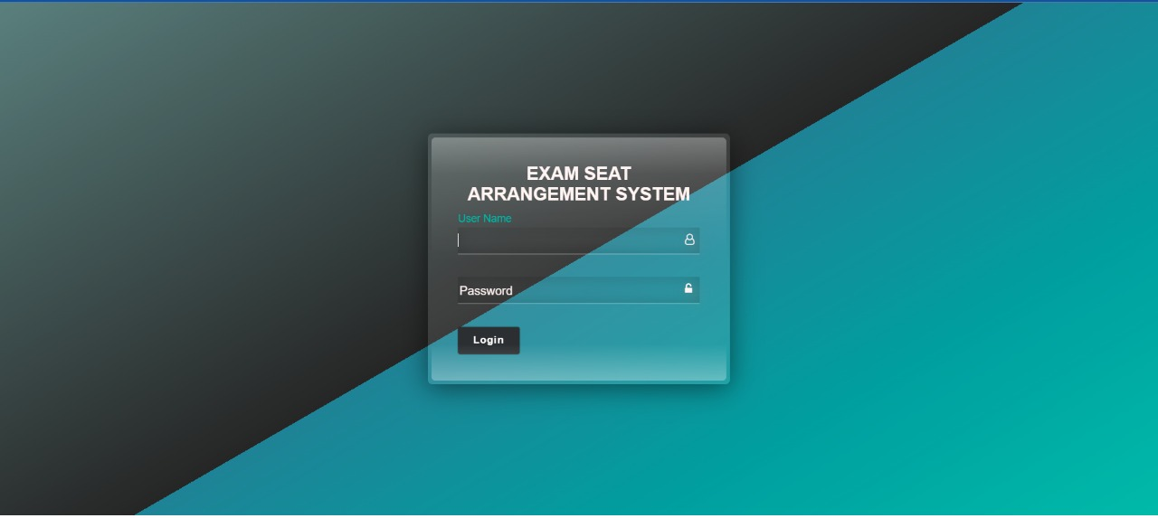
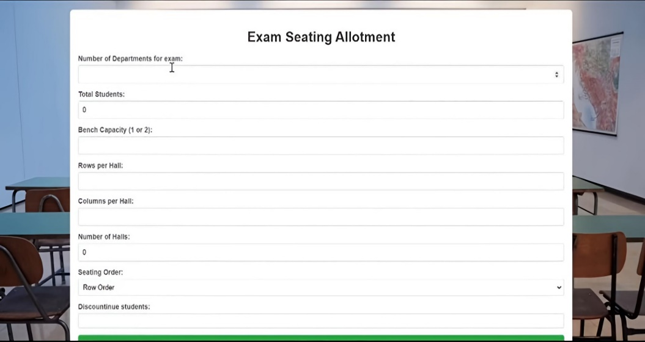
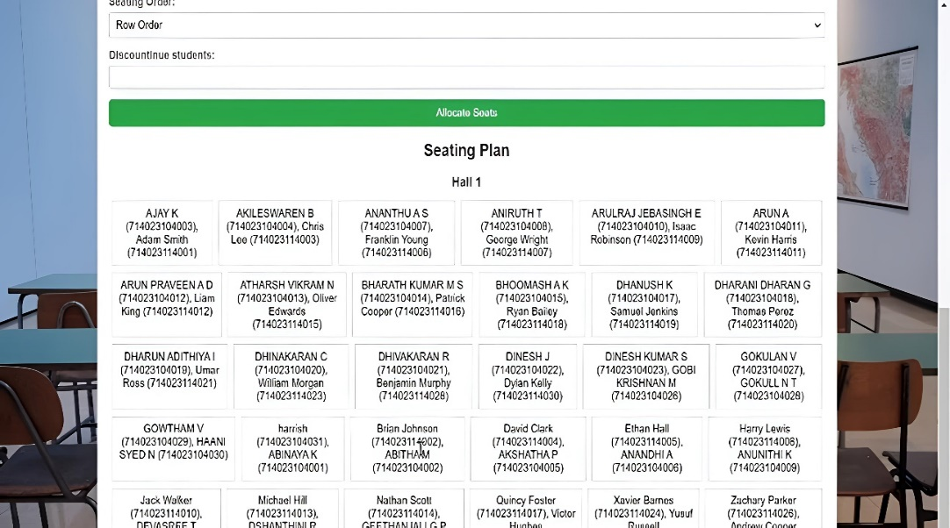
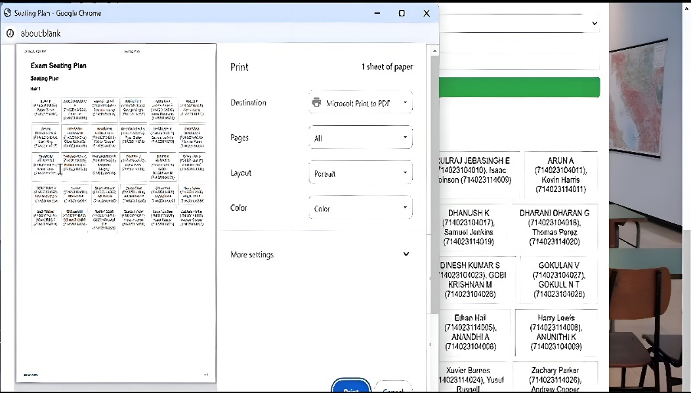
OUTPUT SCREENSHOTS
Date Slide Number

Slide 14
ADVANTAGE OF PROPOSED SYSTEM
Automated Process: Minimal manual work needed.
Conflict-Free Seating: Ensures no duplication or overlaps.
Time-Saving: Swift generation of seat plans.
Dynamic Handling: Easy to handle last-minute changes.
Secure & Controlled Access: Only authorized personnel can make updates.
Report Generation: Ready-to-print seating charts.
Date Slide Number

Slide 15
Conclusion
The Exam Seat Arrangement System streamlines the exam logistics process by leveraging web technologies to automate student seating. It reduces administrative workload, enhances accuracy, and allows flexible, secure management. Its scalable and adaptable architecture makes it a robust solution for modern educational institutions.
Date Slide Number

Slide 16
REFERENCES
[1] IEEE Transactions on Education, "An Automated Seat Arrangement System for Examination Halls: Design and Implementation," Feb. 2023.
[2] IEEE Transactions on Systems, Man, and Cybernetics, "Optimizing Exam Seating with Algorithmic Approaches," Sept. 2022.
[3] Journal of Educational Technology Systems, "Development and Evaluation of a System for Automated Exam Seating," 2024.
[4] International Journal of Artificial Intelligence in Education, "AI-Based Solutions for Managing Large-Scale Exam Seating Arrangements," June 2021.
[5] IEEE Access, "Efficient Seating Plans in Examination Halls: The Role of Automation," 2023.
[6] International Journal of Human-Computer Interaction, "User Experience and Interface Design in Exam Seat Arrangement Systems," 2023.
[7] Educational Technology Research and Development, "Evaluating the Effectiveness of Automated Systems in Exam Scheduling and Seating," Jan. 2024.
[8] International Conference on Intelligent Systems, "Application of AI for Optimized Seating in Educational Exams," 2023.
[9] Journal of Computer Science Education, "Automated Room and Seating Arrangement Systems: A Case Study," Dec. 2022.
[10] arXiv, "Developing an AI-Based System for Optimizing Seating Arrangements in Educational Examinations," 2024.
Date Slide Number

Slide 17
THANK YOU
Date Slide Number

